Slide 1
Bridge Tester
Ben Holleran
Carter Mealey

Slide 2
What We Will Discuss
The background of the course and project
Our solution
System diagrams
Areas of responsibility
Estimated Timeline
Budget
Conclusion
Notes:
We will discuss the background of our project and the course goals. We will also go over our solution to the selected project and show our system diagram. Areas of responsibility will be reviewed as well as a preliminary timeline and rough budget.

Slide 3
Course Background
Student design project
Vermont Technical College senior projects
Select project from list provided
Communicate with client to determine specs
Create design to meet specs
Review design with client and project managers
Create new specs and adjust design direction
Revise design to reflect changes
Build design while working with client
Final presentation
Notes:
This course is a year long course spread over the two senior semesters. We were tasked with picking a project from a list. For our projects we must communicate with our clients and create a design that fulfills the design requirements. As the project progresses and matures, meetings with the clients will continue to show progress and address concerns. The design will be revised to reflect the changes that the client requests. At the end of April the projects will be demonstrated and presented.

Slide 4
Project Background
Selected project: Bridge Tester
Design and build testing equipment compatible with Trotski Competition
Design project to be open source
Budget | $7000
Clients | John Diebold Gordon Reynolds
Notes:
Our project is to build a bridge tester that is compatible with the Troitski Bridge Competition in April. Our clients are John Diebold and Gordon Reynolds who are both Architecture professors at VTC. We were given a design budget of around $7000 to work with. We added an extra specification to our project that it should be open source so other schools can make their own based on our design.

Slide 5
Final Specs
1 meter span – Troitski Competition compatible
10 Tons – Allows for shorter span bridges to be tested
Mobile enough to move between buildings
Load display visible across Judd Gym
Accurate to 1% Load
Precise to 1% between bridges
14” Piston Throw – Allows different height bridges to be tested
Notes:
We are basing our design off the tester used at the Troitski competition in Montreal. We hope to make a tester that will allow the students here at VTC to practice by testing bridges here before going up to Montreal. We also hope that by making the tester available here at VTC, we can hold competitions for the local high schools and potentially colleges in the region.
We have worked out some of the preliminary specs with the architecture professors:
The tester will have the ability to test a bridge with a 1 meter span.
The current record at the Troitski competition is only 3.2 tons, so we will make our tester strong enough to break a bridge with 5 tons.
One of the things that we noticed while looking at the current Troitski tester is that it is very heavy and hard to move around. We will be designing our tester so it can be moved into Judd gym by two people. This means it needs to be able to be carried down stairs and fit through a single standard door.
We will be trying to make the tester accurate to within 1%. This means that the displayed load will be within 1% of the true force applied to the bridge
We will also try to ensure that the Displayed load will be precise to within 1 lb, the smallest unit we will be measuring, between competitions. This will ensure that a bridge breaking at 501lb really did take more force than the bridge that broke at 500lb earlier that afternoon.
The tester will have a 14” throw enabling the competition to “serve” bridges of different heights

Slide 6
Final Design
Hydraulic Cylinder
Truss instead of I-Beam to save weight
Raspberry Pi as controller
HDMI monitor for force over deflection readout
I²C interface
4” LED 7 segment display for load
Deflection data
Load data
Web interface to download logs.
Notes:
Our preliminary design consists of a hydraulic cylinder fixed to the top of a truss frame design. The frame must fit a bridge with a span of a meter within it. The hydraulic cylinder has a stroke of 14” which should allow for plenty of reach. We are using a steel truss design over an I-Beam design in order to save overall weight while maintaining high structural strength and rigidity. A 7-Segment with 3” tall characters will be used to allow the audience to clearly see the current load value from a distance. A Raspberry Pi microcomputer will be used as the main controller for our project. It has the power of a standard computer with the low price and super small size of a microcontroller. An LCD screen with a custom GUI showing deformation in live time will be connected directly to the Raspberry Pi using an HDMI cable. A web interface will also be designed to allow for the downloading of run logs from remote locations.

Slide 7
Large 7-Segment Display
LCD Screen
HDMI Cord
8888
Pressure
Line
Hydraulic
Cylinder
Control box:
Raspberry Pi
I2C A2D
Force
Deflection
Switches
Bridge Goes Here
Hydraulic Pump
3in x 3in Hollow
Steel Tubing Frame
Large Castors
Notes:
Our design consists of a steel frame with trusses made from 2in square tubing. This allows for great strength while maintaining relatively low weight. There is a hydraulic cylinder with a large throw of around 14”. The cylinder is pressurized with a large hydraulic pump powered by an electric motor. There is a control box on the side of the frame for the operator to control the tester. There is a Raspberry Pi inside control box that controls 7-Segment display, the LCD screen, hydraulic pump, and reads the pressure gauge using various interface methods all translated over the GPIO pins. The frame is on wheels for easy mobility.

Slide 8
Work Breakdown
Areas of Responsibility |  |  |  | Mechanical
Ben |  | Carter |  | Electrical
Hydraulics |  | Frame |  | Software
Force Sensor |  | Monitor and 7-Segment
HDMI Display GUI |  | HDMI Display GUI
Mounting Points on Frame |  | Mounting Points on Frame
Website |  | Website

Slide 9
Final Budget
Name | Qt | Price | Shipping | Total
Electronics |  |  |  |  | $ 600.95
7 segment display | 5 | $ 16.46 | $ 15.00 | $ 97.30
Rasberry Pi | 1 | $ 55.00 | $ 12.72 | $ 67.72
Monitor | 1 | $ 136.00 | $ - | $ 136.00
hdmi cord | 1 | $ 5.79 | $ - | $ 5.79
i2c ADC | 1 | $ 14.95 | $ 4.07 | $ 19.02
Switches | 1 | $ 5.95 | $ - | $ 5.95
Misc | 1 | $ 150.00 | $ - | $ 150.00
Darlington Array | 6 | $ 2.00 | $ 4.43 | $ 16.43
USB external HDD | 1 | $ 28.00 | $ 7.49 | $ 35.49
7-Seg I2C | 5 | $ 5.95 | $ 7.50 | $ 37.25
Wireless router | 1 | $ 30.00 | $ - | $ 30.00
 |  |  |  | $ -
Hydraulics |  |  |  |  | $ 1,676.16
Pump | 1 | $ 171.75 | $ 24.32 | $ 196.07
Motor | 1 | $ 123.00 | $ - | $ 123.00
Cylinder | 1 | $ 236.50 | $ - | $ 236.50
Sensor (0-5V) | 1 | $391.50 | $ - | $ 391.50
Lines | 5 | $ 100.00 | $ - | $ 500.00
Valve | 1 | $ 85.00 | $ - | $ 85.00
Tank | 1 | $ 70.00 | $ - | $ 70.00
Filter housing | 1 | $ 40.00 | $ - | $ 40.00
Filter Cartridge | 1 | $ 20.00 | $ - | $ 20.00
 |  |  | $ - | $ -
Motor Coupling | 1 | $ 4.22 | $ - | $ 4.22
Pump Coupling | 1 | $ 5.29 | $ - | $ 5.29
Coupling Spider | 2 | $ 2.29 | $ - | $ 4.58
 |  |  | $ - | $ -
 |  |  |  | $ -
Mechanical |  |  |  |  | $ 491.52
Castors | 4 | $ 47.88 | $ - | $ 191.52
Misc Hardware | 1 | $ 300.00 | $ - | $ 300.00
 |  |  | $ - | $ -
 |  |  | $ - | $ -
 |  |  | $ - | $ -
 |  |  | $ - | $ -
 |  |  | $ - | $ -
 |  |  | $ - | $ -
 |  |  | $ - | $ -
Raw Materials |  |  |  |  | $ 315.21
Frame Steel | 0 | $ - | $ - | $ -
0 | .00 ft | $ 2.33 | $ - | $ -
0 | .00 ft | $ 3.63 | $ - | $ -
0 | .00 ft | $ 12.06 | $ - | $ -
Steel Cuts at Capitol | 6 | $ 10.00 | $ - | $ 60.00
 |  | $ - | $ - | $ -
 |  | $ - | $ - | $ -
Paint | 10 | $ 7.00 | $ - | $ 70.00
Aluminum plate 1'x6'x.5" | 1 | $ 185.21 | $ - | $ 185.21
Category | Total
Electronics | $ 600.95
Hydraulics | $ 1,676.16
Mechanical | $ 491.52
Raw Materials | $ 565.43
Total | $ 3,334.06
Name | Qt | Price | Shipping | Total
Electronics |  |  |  |  | $ 600.95
7 segment display | 5 | $ 16.46 | $ 15.00 | $ 97.30
Rasberry Pi | 1 | $ 55.00 | $ 12.72 | $ 67.72
Monitor | 1 | $ 136.00 | $ - | $ 136.00
hdmi cord | 1 | $ 5.79 | $ - | $ 5.79
i2c ADC | 1 | $ 14.95 | $ 4.07 | $ 19.02
Switches | 1 | $ 5.95 | $ - | $ 5.95
Misc | 1 | $ 150.00 | $ - | $ 150.00
Darlington Array | 6 | $ 2.00 | $ 4.43 | $ 16.43
USB external HDD | 1 | $ 28.00 | $ 7.49 | $ 35.49
7-Seg I2C | 5 | $ 5.95 | $ 7.50 | $ 37.25
Wireless router | 1 | $ 30.00 | $ - | $ 30.00
 |  |  |  | $ -
Hydraulics |  |  |  |  | $ 1,676.16
Pump | 1 | $ 171.75 | $ 24.32 | $ 196.07
Motor | 1 | $ 123.00 | $ - | $ 123.00
Cylinder | 1 | $ 236.50 | $ - | $ 236.50
Sensor (0-5V) | 1 | $391.50 | $ - | $ 391.50
Lines | 5 | $ 100.00 | $ - | $ 500.00
Valve | 1 | $ 85.00 | $ - | $ 85.00
Tank | 1 | $ 70.00 | $ - | $ 70.00
Filter housing | 1 | $ 40.00 | $ - | $ 40.00
Filter Cartridge | 1 | $ 20.00 | $ - | $ 20.00
 |  |  | $ - | $ -
Notes:
We were given a budget of around $7000. At this point in time we have done some general speccing and estimated some costs for unexpected and unspecified bits of hardware. At the moment our electronics total comes up to around $400, the hydraulics to about $1000, the mechanical to around $350, and the raw materials to around $500. This brings our total to just under $2300 which is significantly under budget. We are sure there will be unexpected costs to increase the total project costs but we will still come in quite a bit under budget.

Slide 10
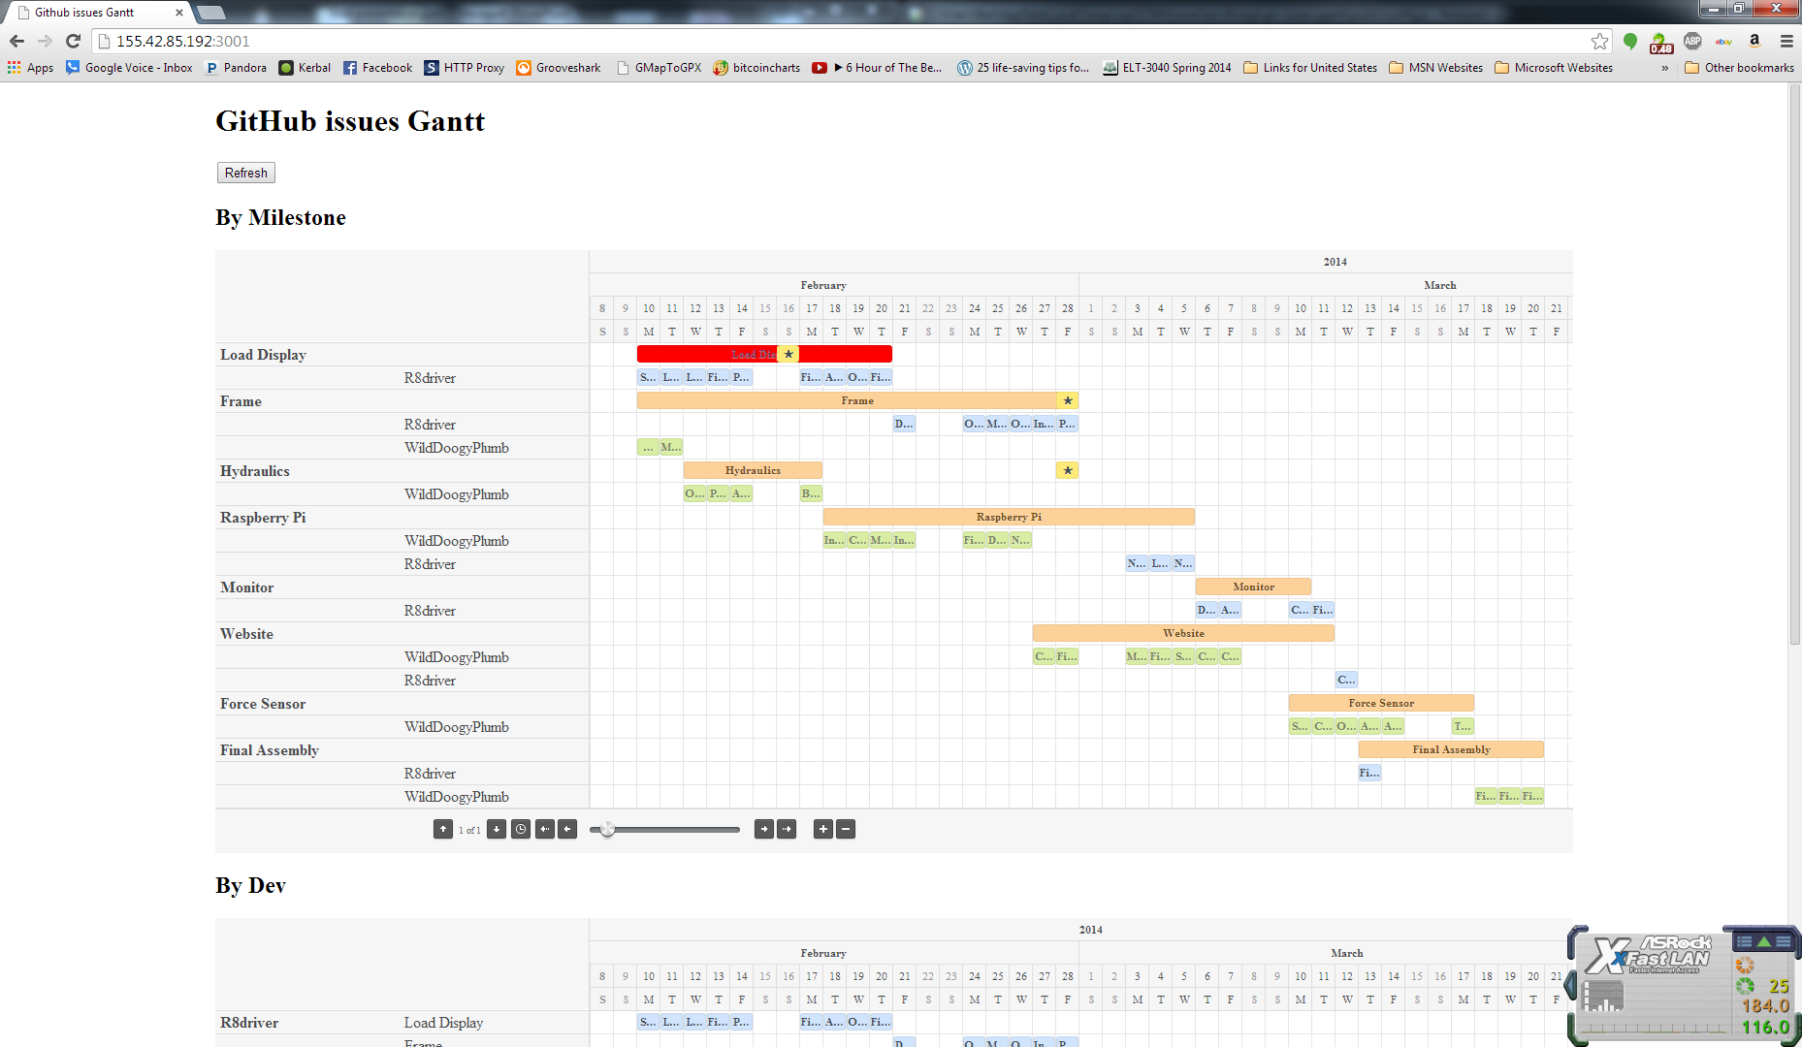
Project Management
Project managed on GitHub
Put Gaant chart screen shot here
Carter Ben

Slide 11
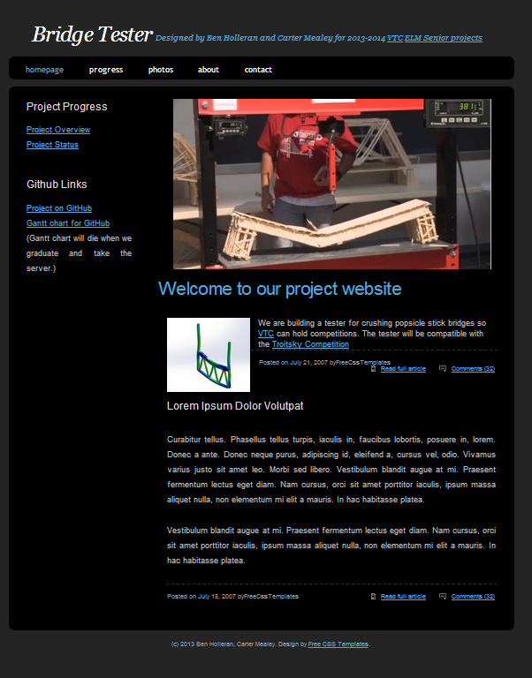
Website
Found server to host on
Found template
Need to add content
Need to migrate to VTC servers

Slide 12
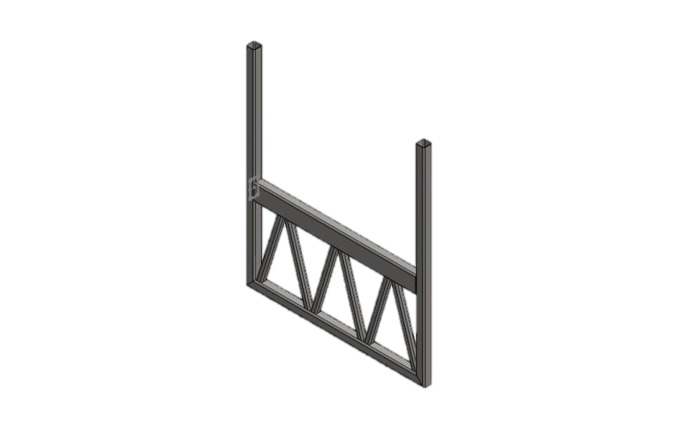
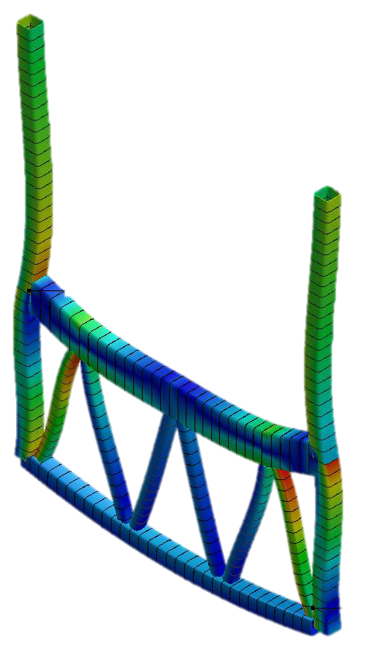
The Frame
Minimum Safety Factor is 2
Truss Is lighter and stiffer than I beam

Slide 13
Hydraulic Subsystem
1 ½ NPT
¾ NPT
¾-16
½ NPT
Valve has built in pressure relief
¼ NPT
Pressure Sensor

Slide 14
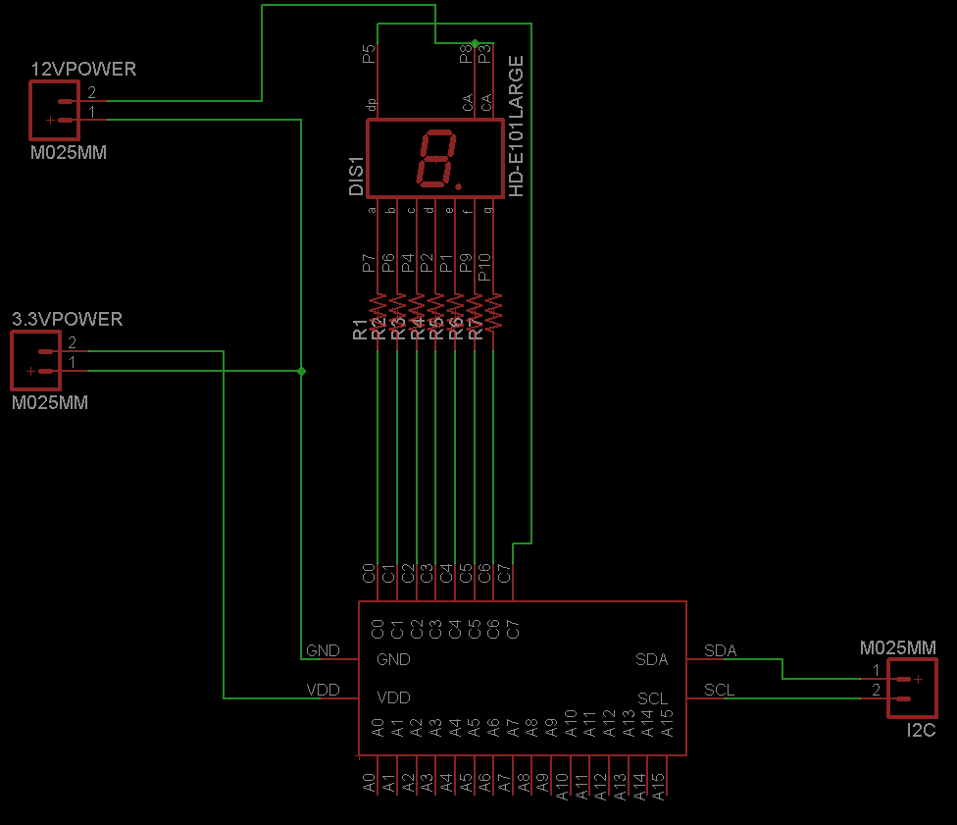
I²C 7 segment schematic
200 ohm

Slide 15
Current Project Status
Parts are identified and budget is finalized.
Ordering is to begin the week of 2/9/14
Testing and assembly of select subsystems is currently in progress (A2D converter)

Slide 16
Conclusion
In Conclusion:
Design meets Course specs
Design meets Client specs
Design is constructible within timeframe
Design is within budget
Notes:
Our project fulfills all of the requirements for the class. It has the required amount of mechanical, electrical, and software specifications. Our design fulfills the specifications of Mr. Diebolds the client. Our project will be able to be constructed in a timely fashion and will fall within our budget constraints.

Slide 17
Questions?

